Slide 1

Capstone: Attribution
Learn SQL from Scratch
Vanisha Hirji
July 2018

Slide 2
Table of Contents
Get familiar with CoolTShirts
What is the user journey?
Optimize the campaign budget

Slide 3
1. Get Familiar with the CoolTShirts

Slide 4
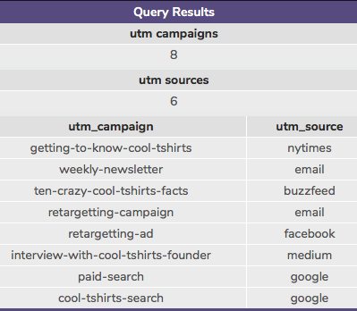
1. How many campaigns & sources does CoolTShirts use?
This was some simple code, to retrieve distinct campaigns and sources.
-- You can put your query here
select count(DISTINCT utm_campaign) as 'utm campaigns'
from page_visits;
select count(DISTINCT utm_source) as 'utm sources'
from page_visits;
select distinct utm_campaign, utm_source
from page_visits;

Slide 5
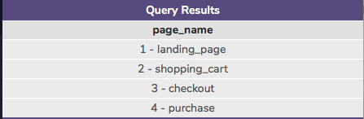
2. What pages are on the CoolTShirts website?
This was again some simple code, to retrieve distinct page name on the website so it was similar to what I wrote for the previous query.
-- You can put your query here
select distinct page_name
from page_visits;

Slide 6
1. What is the User Journey?

Slide 7
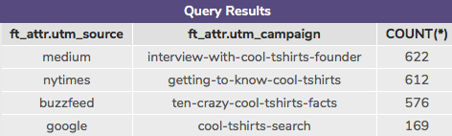
3. How many first touches is each campaign responsible for?
I struggled with this, I heavily used the hint, I just could not get my head around how to do this.
-- You can put your query here
WITH first_touch AS (
SELECT user_id,
MIN(timestamp) as first_touch_at
FROM page_visits
GROUP BY user_id),
ft_attr AS (
SELECT ft.user_id,
ft.first_touch_at,
pv.utm_source,
pv.utm_campaign
FROM first_touch ft
JOIN page_visits pv
ON ft.user_id = pv.user_id
AND ft.first_touch_at = pv.timestamp
)
SELECT ft_attr.utm_source,
ft_attr.utm_campaign,
COUNT(*)
FROM ft_attr
GROUP BY 1, 2
ORDER BY 3 DESC;

Slide 8
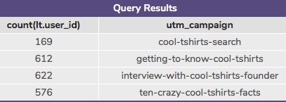
4. How many last touches is each campaign responsible for? 1st Attempt
I initially tried writing this from scratch though I got an answer I suspected it maybe incorrect, the next slide shows my second attempt at this question.
-- You can put your query here
WITH last_touch AS (
SELECT user_id,
MIN(timestamp) as last_touch_at
FROM page_visits
GROUP BY user_id)
SELECT count(lt.user_id), pv.utm_campaign
FROM last_touch lt
JOIN page_visits pv
ON lt.user_id = pv.user_id
AND lt.last_touch_at = pv.timestamp
group by pv.utm_campaign;

Slide 9
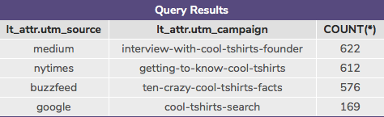
4. How many last touches is each campaign responsible for?
2nd Attempt
I used the first touch code provided from the previous query and amended it to last touch, then added a count and stripped away unnecessary columns.
I got the same answers when I wrote out the query this way so it confirmed what I did initially on my first attempt.
-- You can put your query here
WITH last_touch AS (
SELECT user_id,
MIN(timestamp) as last_touch_at
FROM page_visits
GROUP BY user_id),
lt_attr AS (
SELECT lt.user_id,
lt.last_touch_at,
pv.utm_source,
pv.utm_campaign
FROM last_touch lt
JOIN page_visits pv
ON lt.user_id = pv.user_id
AND lt.last_touch_at = pv.timestamp
)
SELECT lt_attr.utm_source,
lt_attr.utm_campaign,
COUNT(*)
FROM lt_attr
GROUP BY 1, 2
ORDER BY 3 DESC;

Slide 10
1. Optimise the Campaign Budget

Slide 11
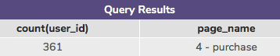
5. How many visitors make a purchase?
This was a nice simple question after the previous one, counted the number of id that had landed on the purchase page. I also double checked for distinct user ids, however the result was the same.
-- You can put your query here
Select count(user_id), page_name
from page_visits
where page_name = '4 - purchase';

Slide 12
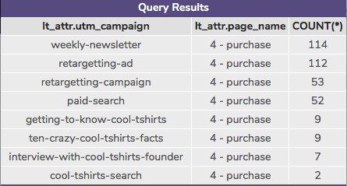
6. How many last touches on the purchase page is each campaign responsible for?
This was built up using the learning from the first/last touch questions.
I hope it’s correct!
-- You can put your query here
with last_touch as (SELECT user_id, max(timestamp) as last_touch_at
FROM page_visits
GROUP BY user_id),
lt_attr as (
Select lt.user_id, pv.page_name, pv.utm_campaign, lt.last_touch_at
from last_touch lt
join page_visits pv
ON lt.user_id = pv.user_id AND lt.last_touch_at = pv.timestamp)
SELECT lt_attr.utm_campaign, lt_attr.page_name,
COUNT(*)
FROM lt_attr
where lt_attr.page_name = '4 - purchase'
GROUP BY 1, 2
ORDER BY 3 DESC;

